Slide 1
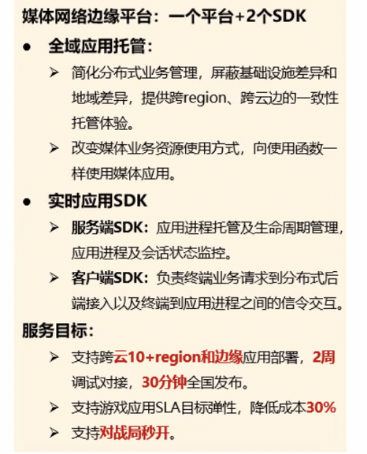
全域应用的托管平台
APP
“全域”-> Regionless
“应用托管”-> Application Hosting
APP
APP
DB APP
DB APP
APP
DB APP
Regionaless Hosting Platform
Region A
Region N
Region B
Edge Sites
CDN Sites
Use Cases
Requirements
Design Thoughts

Slide 2
Use Case 1
Region 1
Region 2
Region 3
Stateless CP
Stateless CP
Stateless CP
Workloads (pods, deployments, etc.)
Nodes
VPC, Subnets
…
etcd
etcd
etcd
R2
R3
R1
Use Cases
Requirements
Design Thoughts

Slide 3
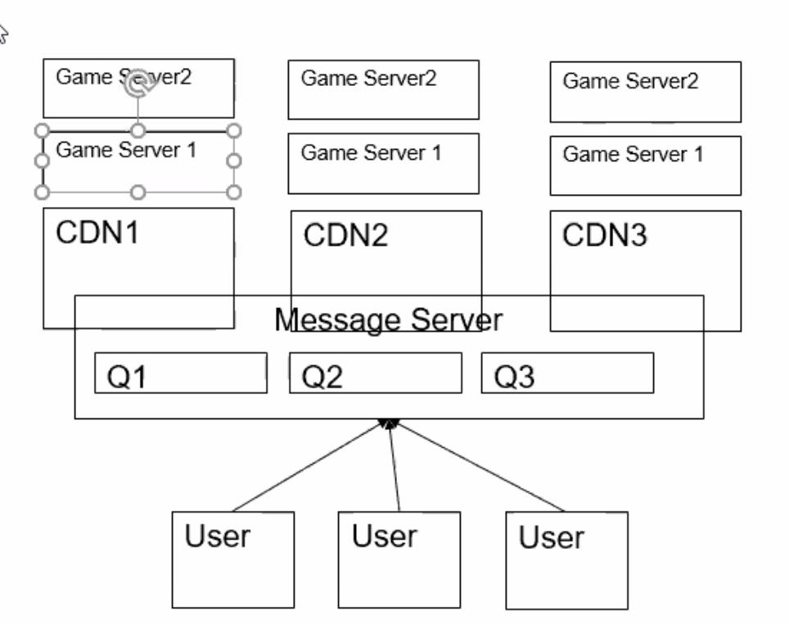
Use Case 2
Region 1
Region 2
Region 3
Game Instance
Game Instance
Game Instance
Game Instance
Game Instance
Game Instance
Original sketch by Fei
Game Instance
Game Instance
Game Instance
”pub”
Topic X
Topic X
Topic X
radis
radis
radis
Topic Y
Topic Y
Topic Y
”sub”
Client 1
Client 6
Client 2
Client 5
Client 3
Client 4
Use Cases
Requirements
Design Thoughts

Slide 4
Use Case 3
Region 1
Region 2
Region 3
Game Instance
Game Instance
Game Instance
Game Instance
Game Instance
Game Instance
Game Instance
Game Instance
Game Instance
Edge Serverless Platform
Edge Serverless Platform
Edge Serverless Platform
Games Lobby
{
player 1,
player 2,
player 3,
player 4,
}
Games Lobby
{
player 1,
player 2,
player 3,
player 4,
}
Games Lobby
{
player 1,
player 2,
player 3,
player 4,
}
player 3
player 4
player 1
player 2
Use Cases
Requirements
Design Thoughts

Slide 5
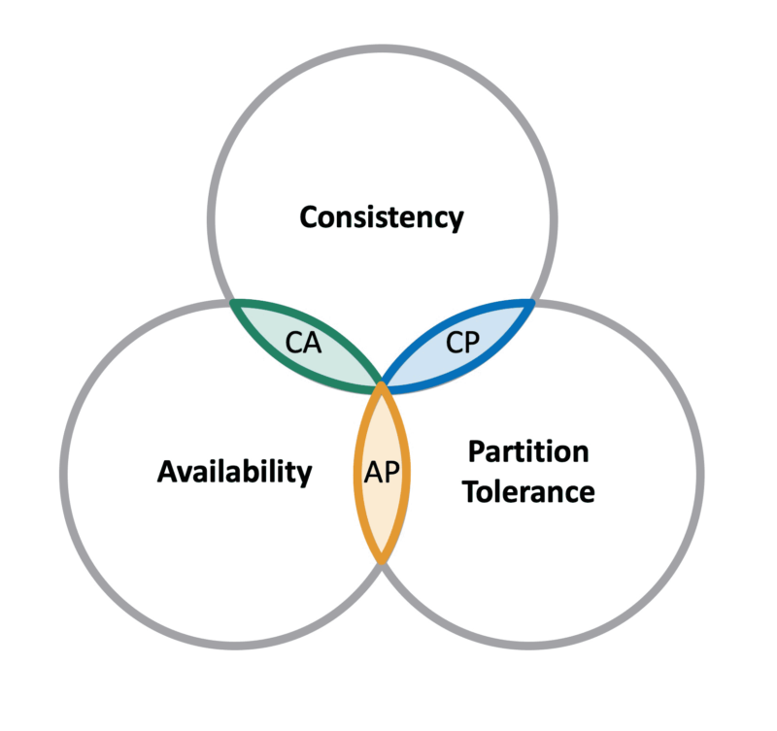
Key Requirements
Performance
Latency
Throughput
Capacity Limit
partition vs full copy
Storage API compatibility
e.g. etcd list-watch
KV put/get
Message Queue pub/sub
Fault Tolerance
Network partition
Storage node failures
Consistency
Strong (e.g. etcd)
Eventual
Use Cases
Requirements
Design Thoughts

Slide 6
Key Requirements
* Innovation possibilities
Performance
Latency
Throughput
Capacity Limit
Partitioned
Unified Storage API compatibility
e.g. etcd CRUD & list-watch
KV put/get
Message Queue pub/sub
Fault Tolerance
Network partition
Storage node failures
Consistency
Within a cluster: C+P (Strong) or A+P (Eventual, master-slave)
Between clusters: A+P (Strong, , master-slave) or “C”+A+P (Eventual, master-master)
Use Cases
Requirements
Design Thoughts

